Slide 1
Purple Day
Epilepsy Awareness
Epilepsy Queensland - Bringing epilepsy out of the shadows 1300 852 853

Slide 2
Who can tell me what epilepsy is?
Epilepsy is when people have seizures
Seizures are all different
Sometimes it causes people to shake all over
Sometimes it makes people go still and quiet
Everybody’s epilepsy is different
Epilepsy Queensland - Bringing epilepsy out of the shadows 1300 852 853
Notes:
Everybody’s epilepsy is different – some seizures are easy to control with medication. Others people have more frequent seizures that are hard to control.

Slide 3
What happens in a seizure?
The electrical signals in the brain get mixed up
Sometimes there are too many messages
Sometimes there are not enough messages
Sometimes the person doesn’t know this is happening
Sometimes the person falls and hurts themselves
Epilepsy Queensland - Bringing epilepsy out of the shadows 1300 852 853
Notes:
The person may not be able to hear you, might say funny things, won’t respond, won’t remember what they’ve done, and sometimes after the seizure they will be very tired.

Slide 4
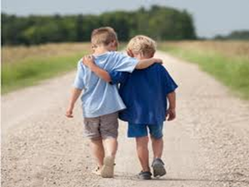
Some children worry about having a seizure at school, or how their friends will react.
Or they worry that people around them won’t know what to do.
Epilepsy Queensland - Bringing epilepsy out of the shadows 1300 852 853
Notes:
OK

Slide 5
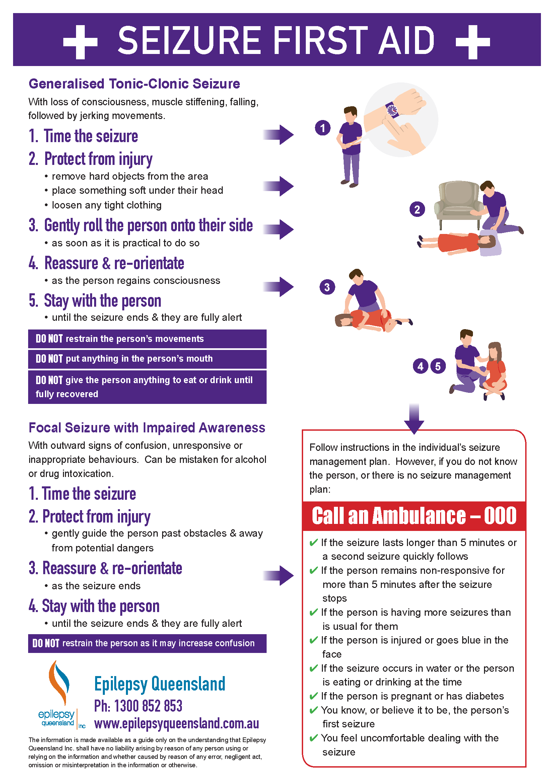
What can you do?
Stay with the person
Send someone to get a teacher
Learn about seizure first aid
Epilepsy Queensland - Bringing epilepsy out of the shadows 1300 852 853

Slide 6
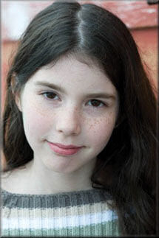
What else you can do!
March is Epilepsy Awareness Month!
Help Epilepsy Queensland celebrate
Purple Day on 26 March.
Purple Day was founded by a nine year old girl in Canada called Cassidy Megan, who wanted to get people talking about epilepsy. This year Epilepsy Queensland wants your help to bring epilepsy out of the shadows.
Epilepsy Queensland - Bringing epilepsy out of the shadows 1300 852 853
Notes:
OK

Slide 7
Purple Day suggestions
Log onto Epilepsy Queensland website at www.epilepsyqueenland.com.au
Download information sheets about Purple Day
Wear something purple on 26 March
Host a purple or mask themed event
Hold a purple face painting party
Buy or sell – ribbons, badges, pens, bracelets, wristbands, masks and bears are available during March
Order free stickers and posters from Epilepsy Queensland for Purple Day
Epilepsy Queensland - Bringing epilepsy out of the shadows 1300 852 853
Notes:
OK

Slide 8
A note will be going home in the newsletter which will have all the details you need. Have fun and good luck!
Go Purple!
Epilepsy Queensland - Bringing epilepsy out of the shadows 1300 852 853
Notes:
OK

